Slide 1
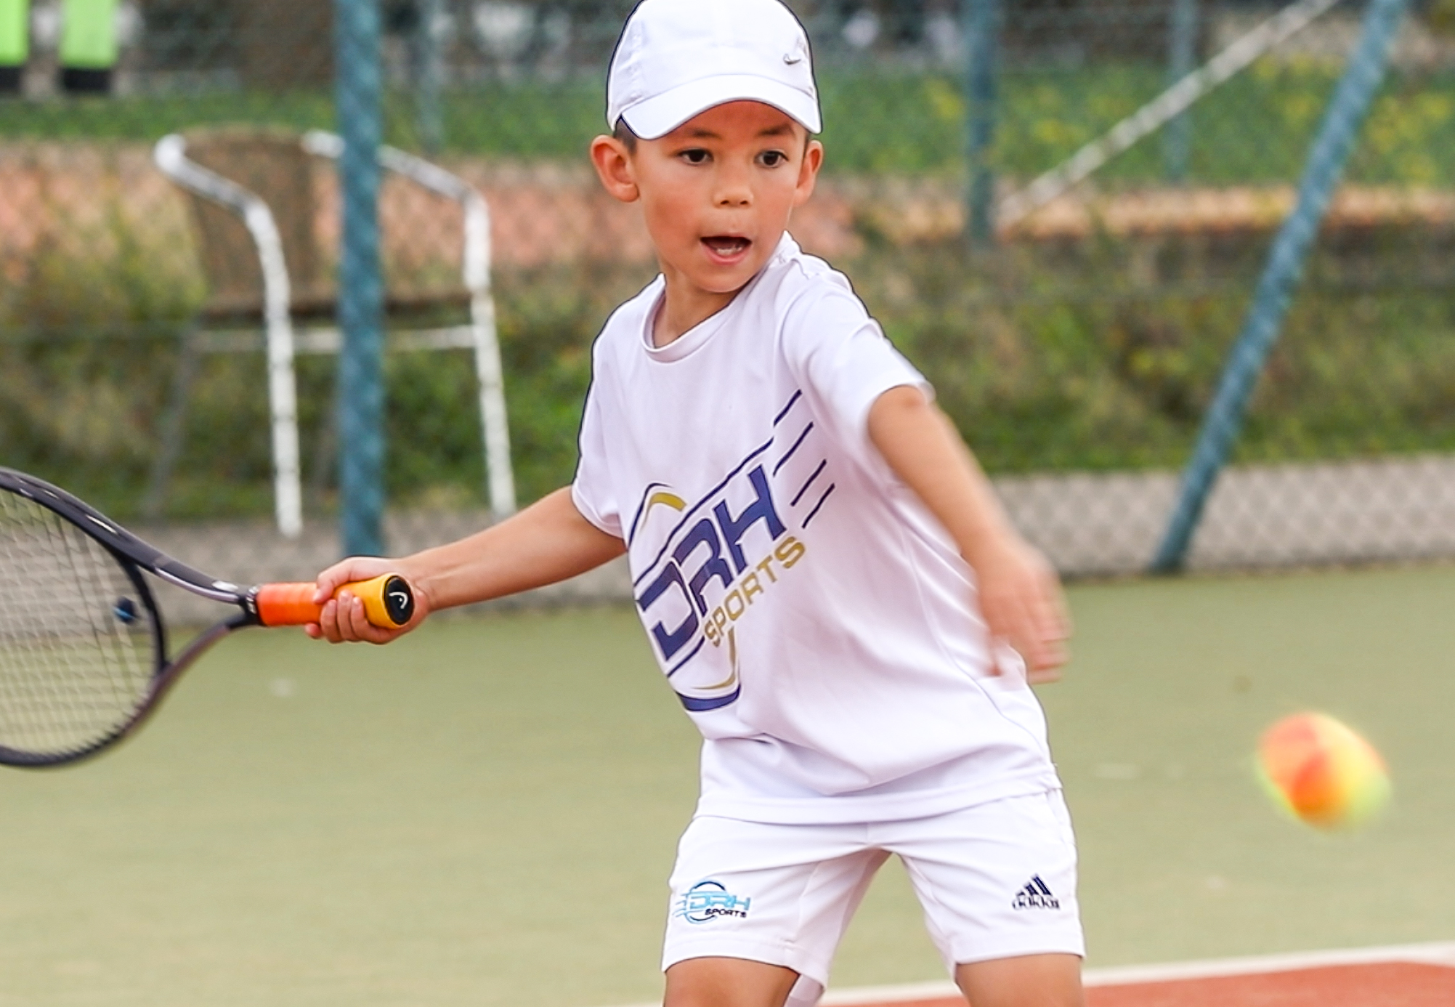
Mini Tots/Red Coaching Programme
Autumn 2024
Day | Group | Time | Court |  | Experience | Coach
Mon | Red Club 1 | 4-5pm | Indoor 1 |  | Aged 5-8 Beginner | Ethan Rouget
Tues | Red Club 2 | 5-6pm | Indoor 1 |  | Aged 5-8 Beginner | Ethan Rouget
Wed | Red Development 1 | 4-5pm | Indoor 1 |  | Aged 5-8 Intermediate | Ethan Rouget
Fri | Red Club 3 | 4-5pm | Indoor 1 |  | Aged 5-8 Beginner | Carla Birks
Sat | Mini Tots 1 | 9.10-9.55am | Indoor 1 |  | Ages 3-4 Beginner | Ethan Rouget
 | Red Club 4 | 9-10am | Indoor 2 |  | Aged 5-8 Beginner | Carla Birks
 | Red Club 5 | 10-11am | Indoor 1 |  | Aged 5-8 Beginner | Carla Birks
 | Red Development 2 | 11am-12pm | Indoor 1 |  | Aged 5-8 Intermediate | Carla Birks
Sun | Mini Tots 2 | 9.10-9.55am | Indoor 1 |  | Ages 3-4 Beginner | Ethan Rouget
 | Red Club 6 | 10-11am | Indoor 1 |  | Aged 5-8 Beginner | Ethan Rouget
 | Red Development 3 | 11am-12pm | Indoor 1 |  | Aged 5-8 Intermediate | Ethan Rouget
Bookings: Go to: www.drhsports.co.uk Info: lstccoaching@drhsports.co.uk |  |  |  | Autumn 2024: 15 weeks Dates: Sept 2nd – Dec 21st
Ages
3-8

Slide 2
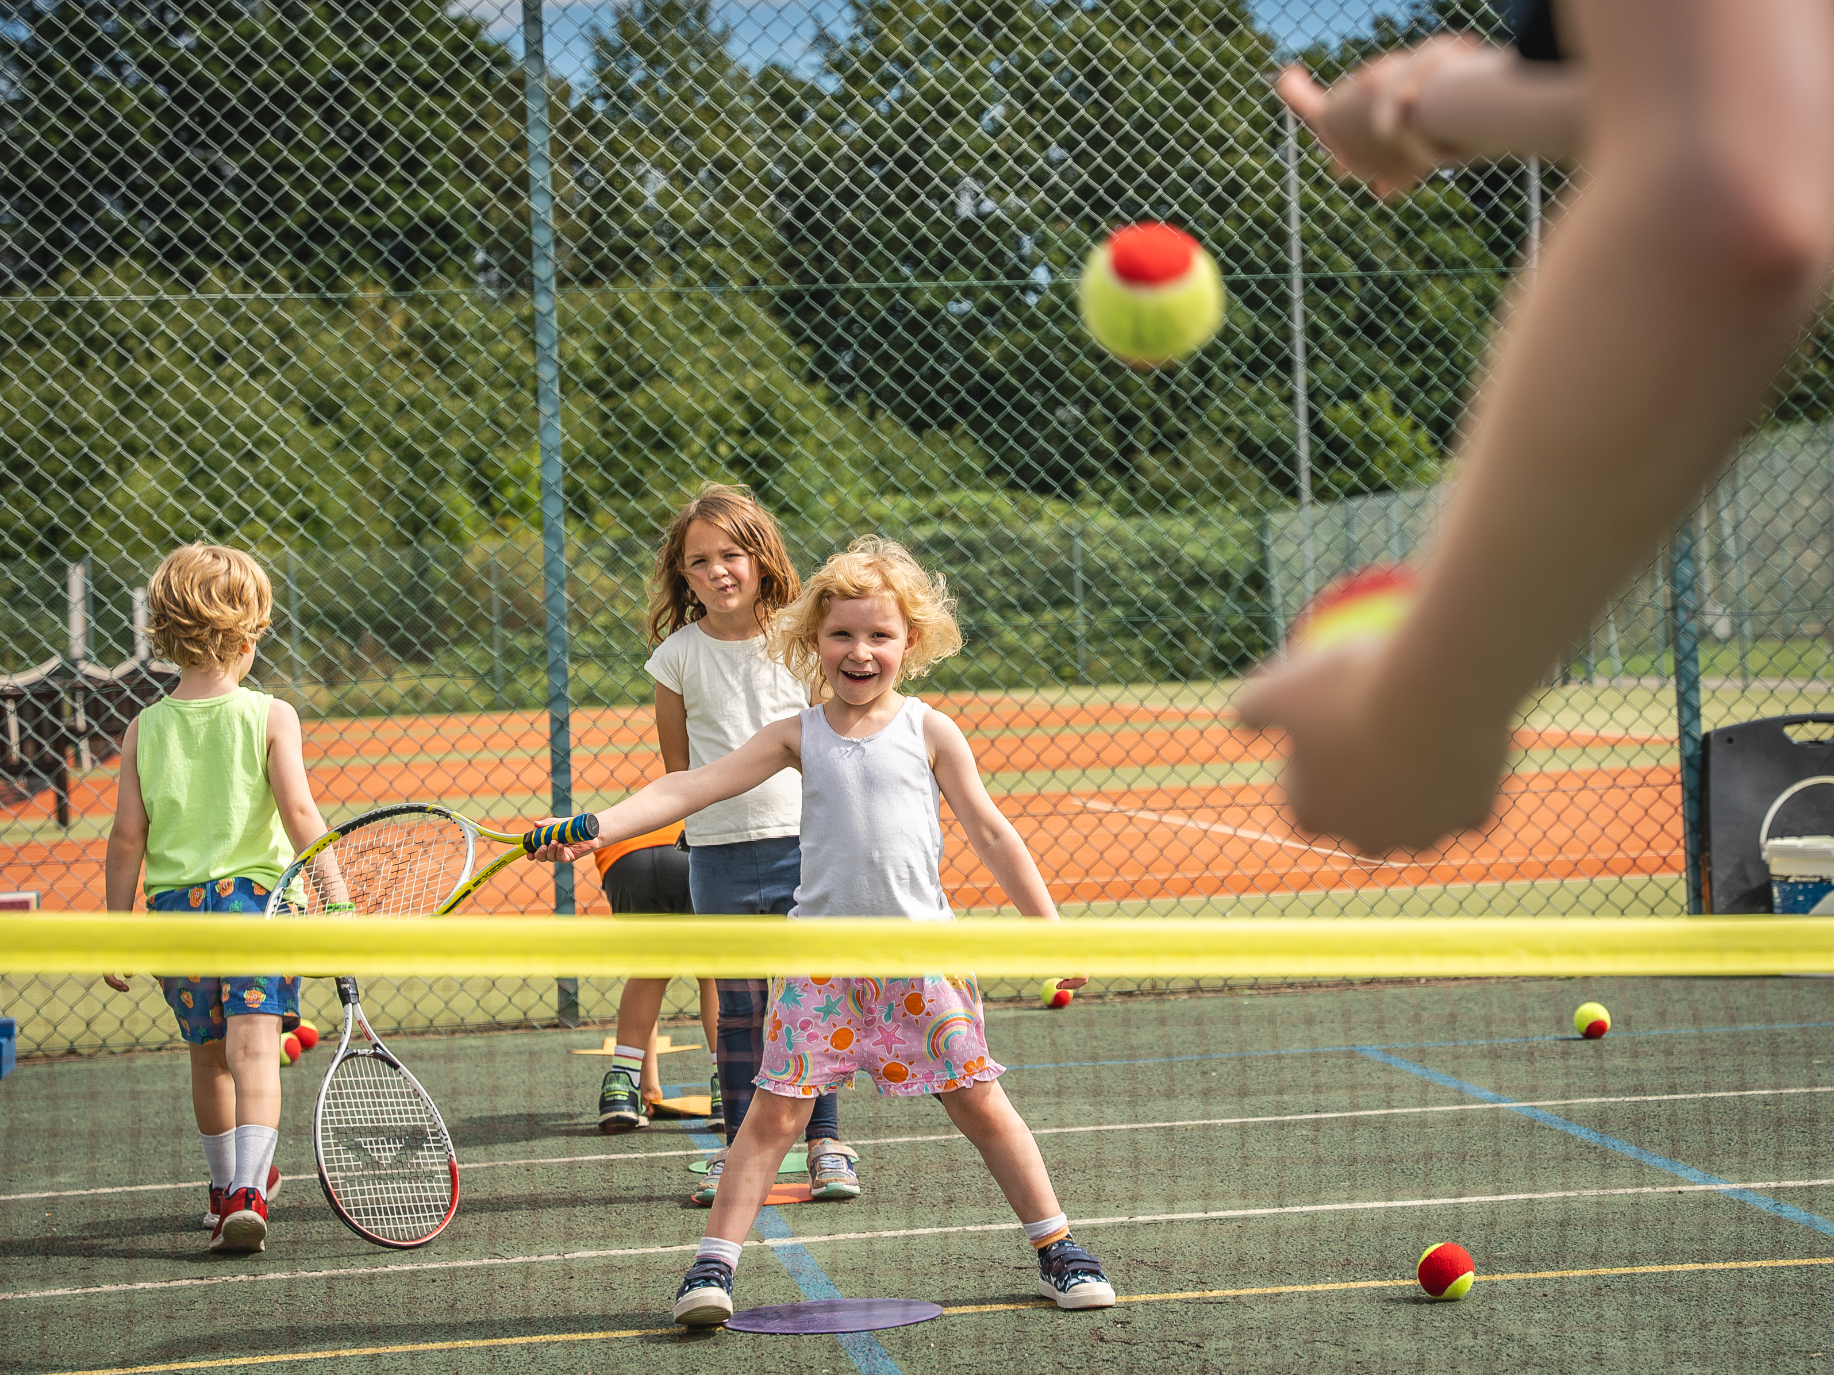
Mini Orange/Green Coaching Programme - Autumn 2024
Day | Group | Time | Court |  | Experience | Coach
Mon | Green Development | 4-5pm | Indoor 2, 3 |  | Aged 10-11 Intermediate | Keith Lancaster
Tues | Orange/Green Dev | 4-5pm | Indoor 2, 3 |  | Aged 8-11 Beginner/Intermediate | Carla Birks
Tues | Green Club 1 | 5-6pm | Indoor 1, 2 |  | Aged 8-9 Beginner | Ethan Rouget
Wed | Orange Club/Dev | 4-5pm | Indoor 2, 3 |  | Aged 8-9 Beginner/Intermediate | John Bennet
Fri | Orange Development | 4-5pm | Indoor 2, 3 |  | Aged 8-9 Intermediate | Keith Lancaster
Sat | Green Club/Dev | 10-11am | Indoor 2, 3 |  | Aged 10 Beginner/Intermediate | John Bennet
 | Orange Development | 11am-12pm | Indoor 2, 3 |  | Aged 8-9 Intermediate | Joe Tirrell
 | Orange/Green Club 1 | 12-1pm | Indoor 1, 2 |  | Aged 8-10 Beginner | Keith Lancaster
 | Orange Club 2 | 1-2pm | Indoor 1, 2, 3 |  | Aged 8-9 Beginner | Ethan Rouget
Sun | Orange/Green Club 2 | 12-1pm | Indoor 1, 2, 3 |  | Aged 8-10 Beginner | Keith Lancaster
Bookings: Go to: www.drhsports.co.uk Info: lstccoaching@drhsports.co.uk |  | Autumn 2020: 14 weeks Dates: Sep 7th – Dec 20th |  | Autumn 2024: 15 weeks Dates: Sept 2nd – Dec 21st | Autumn 2020: 7 weeks Dates: Sep 7th – Dec 20th
Ages
8-11

Slide 3
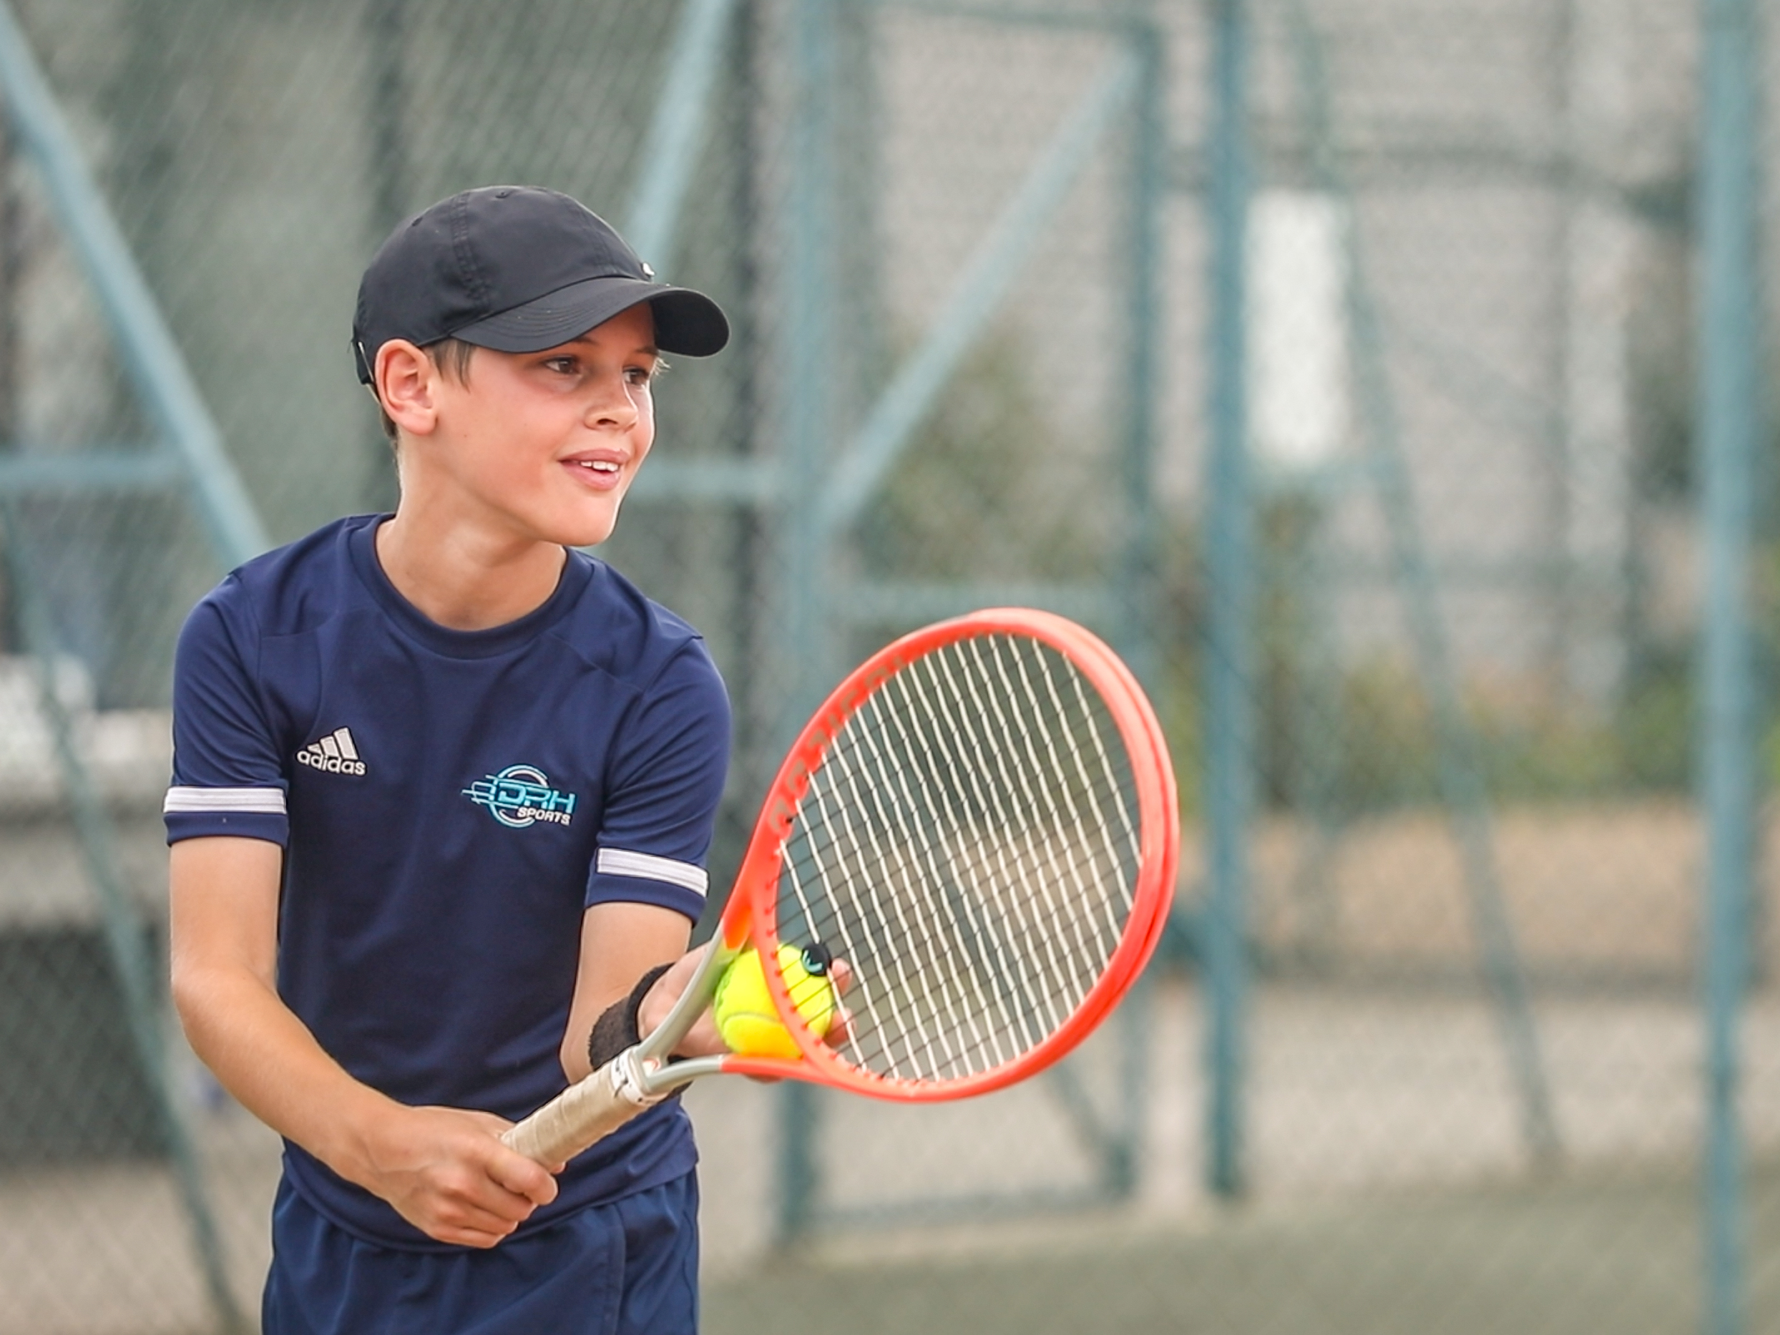
Junior Coaching Programme Autumn 2024
Day | Group | Time | Court | Experience | Coach
Mon | U15 Dev 1 | 5-6pm | Carpet 1-3 | Aged 11-15 Beginner/Intermediate | Keith Lancaster
Tues | U15 Club/Dev | 6-7pm | Clay 1, 2, 3 | Aged 11-15 Beginner/Intermediate | Ethan Rouget
Wed | U18 Team 1 | 5.30-7pm | Carpet 1-3 | Aged 15-18 Intermediate/Advanced | John Bennet
Thurs | U18 Team 2 | 5-6.30pm | Carpet 1-3 | Aged 14-18 Intermediate/Advanced | Keith Lancaster
Fri | U15 Club | 6-7pm | Clay 1, 2, 3 | Aged 11-15 Beginner | Ethan Rouget
 | U15 Dev 2 | 5-6pm | Carpet 1, 2 | Aged 11-15 Intermediate | Carla Birks
Sat | U15 Dev 3 | 12-1pm | Carpet 1-3 | Aged 11-15 Beginner/Intermediate | Carla Birks
Sun | U13 Club | 1-2pm | Carpet 1, 2 | Aged 11-13 Beginner | Keith Lancaster
Bookings: Go to: www.drhsports.co.uk Info: lstccoaching@drhsports.co.uk |  | Autumn 2020: 14 weeks Dates: Sep 7th – Dec 20th |  | Autumn 2024: 15 weeks Dates: Sept 2nd – Dec 21st
Ages
11-17

Slide 4
Adult Coaching Programme Autumn 2024
Day | Group | Time | Court | Experience | Experience | Coach
Mon | Daytime Drills | 11am-12.30pm | Indoor 1, 2 |  | Intermediate | Jerry Rose
Wed | Daytime Drills | 10-11.30am | Indoors 1, 2, 3 | Intermediate | Intermediate | Jerry Rose
Thurs | Cardio Tennis | 9-10am | Indoor 1 | All | All | Joe Tirrell
Fri | Adult Improvers 1 | 9.30-11am | Indoor | Intermediate | Intermediate | Rob McDowell
 | Adult Beginners | 7-8pm | Carpet 1, 2 | All | Beginner | Ethan Rouget
Sat | Adult Improvers 2 | 10-11.30am | Clay 1, 2, 3 | Beginner/Intermediate | Intermediate | Keith Lancaster
Bookings: Go to: www.drhsports.co.uk Info: lstccoaching@drhsports.co.uk |  | Autumn 2020: 14 weeks Dates: Sep 7th – Dec 20th |  | Autumn 2024: 15 weeks Dates: Sept 2nd – Dec 21st
Ages
18+

